Slide 1
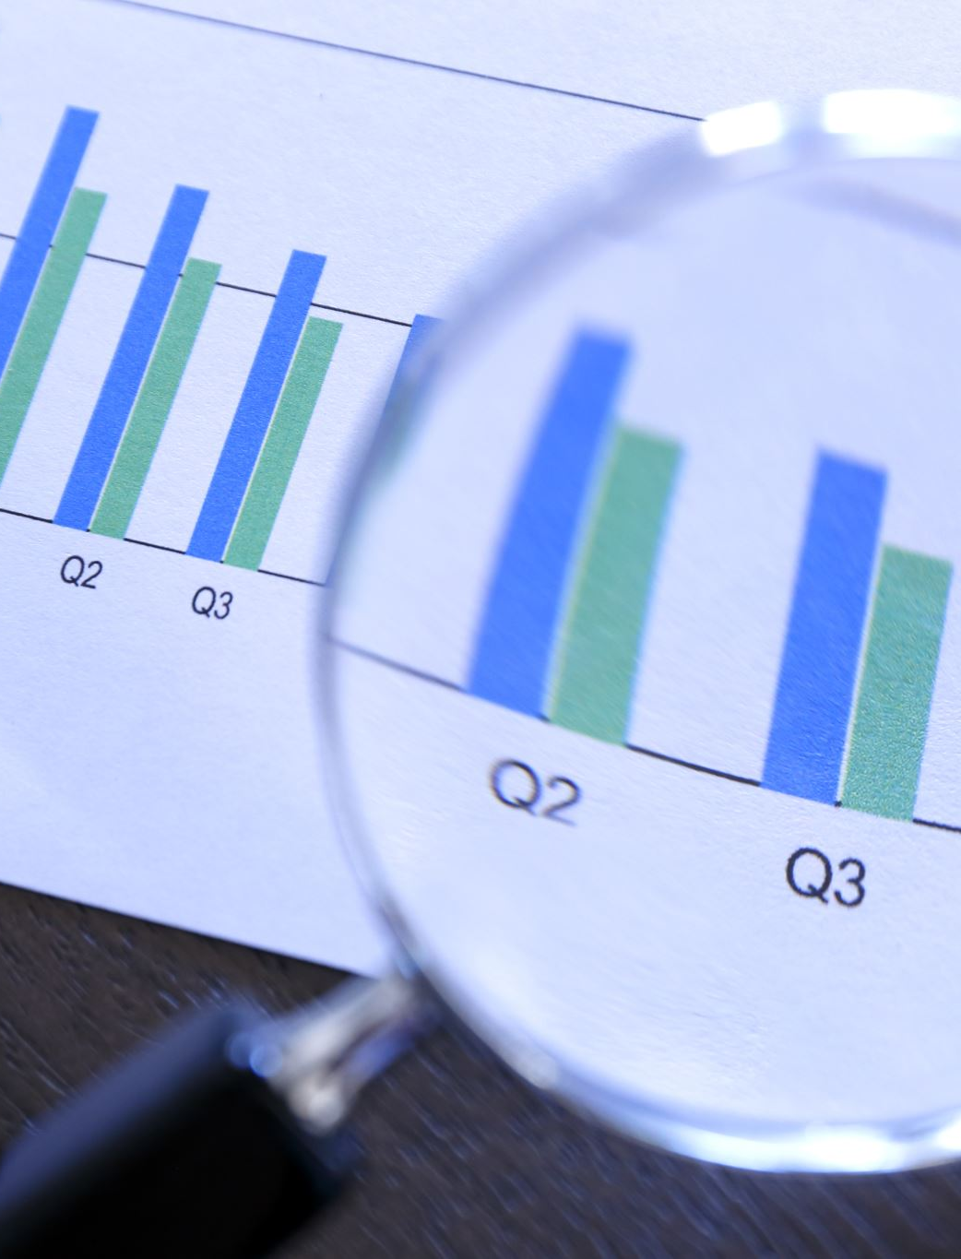
Analyzing and Forecasting Covid-19 Trends

Slide 2
Abstract
In this project, we explore the application of machine learning techniques to predict the spread of Covid-19 cases globally.
Unlike traditional methods, which often rely on expert knowledge and epidemiological models, we employ data-driven approaches to provide accurate predictions of epidemic trends.
Specifically, we utilize the Autoregressive Integrated Moving Average (ARIMA) model, a powerful time series forecasting method, to forecast Covid-19 cases for the next 30 days.

Slide 3
Problem Statement
The problem we are addressing in this project is the prediction of COVID-19 cases for the next few days using machine learning techniques, specifically the ARIMA (AutoRegressive Integrated Moving Average) model. The COVID-19 pandemic has had a significant impact globally, affecting various aspects of society, including public health, the economy, and social behavior. Accurate prediction of COVID-19 cases is crucial for governments, healthcare organizations, and policymakers to make informed decisions and implement effective strategies to mitigate the spread of the virus and allocate resources efficiently.

Slide 4
Dataset
The dataset used in the project is related to COVID-19 cases and deaths worldwide. It contains information on the number of confirmed cases and deaths reported for each country or region on specific dates. The dataset likely includes columns such as:
Date: Date of reporting the COVID-19 data.
Country/Region: Name of the country or region for which the COVID-19 data is reported.
Cases: Number of confirmed COVID-19 cases reported on the given date.
Deaths: Number of COVID-19 related deaths reported on the given date.

Slide 5
Python Libraries:-
pandas: For data manipulation and analysis.
numpy: For numerical computing.
matplotlib: For data visualization.
statsmodels: For time series analysis and modeling.
sklearn: For machine learning algorithms and evaluation metrics.
pmdarima: For automated ARIMA model selection.

Slide 6
The primary objectives of this project include:
Data Collection: Gather COVID-19 data from reliable sources such as global health organizations, government agencies, or public databases. The dataset should include information on the number of confirmed cases, deaths, recoveries, and other relevant metrics, aggregated by country or region over time.
Data Preprocessing: Cleanse and preprocess the raw data to handle missing values, outliers, and inconsistencies. Perform necessary transformations such as converting data types, aggregating data at the desired granularity (e.g., daily or weekly), and normalizing the data if required.
Model Selection: Choose an appropriate machine learning model for time series forecasting, considering factors such as model performance, interpretability, and computational efficiency. In this project, we utilize the ARIMA model, a widely used technique for forecasting time series data.
Model Training: Train the ARIMA model using historical COVID-19 data to learn patterns and trends in the time series. Split the dataset into training and testing sets to evaluate the model's performance accurately.
Model Evaluation: Evaluate the trained ARIMA model's performance using appropriate evaluation metrics such as R-squared (R2) score, Mean Absolute Error (MAE), Mean Squared Error (MSE), or other relevant metrics. Assess the model's ability to capture the underlying patterns and variability in the data and its predictive accuracy.
Hyperparameter Tuning: We used automated hyperparameter tuning techniques, such as the auto_arima function from the pmdarima library, to find the optimal parameters for the ARIMA model.

Slide 7
Utilizing ARIMA Modeling for COVID-19 Cases Prediction: A Data-Driven Approach
In our implementation, we followed standard procedures for ARIMA modeling. We preprocessed the COVID-19 cases data, splitting it into training and testing sets, and conducted hyperparameter tuning using auto_arima from the pmdarima library to determine the optimal parameters for the ARIMA model.
We trained the ARIMA model on the training data and then used it to forecast COVID-19 cases for the specified forecast period.
By leveraging the ARIMA model, we aimed to provide accurate and reliable predictions of COVID-19 cases, contributing valuable insights for policymakers and healthcare professionals in combating the pandemic and implementing effective strategies for disease control and prevention

Slide 8
Conclusion
Our COVID-19 case prediction model marks a significant advancement in harnessing cutting-edge technology to tackle global health challenges. Through the utilization of data analytics and machine learning algorithms, we have successfully developed a predictive model capable of forecasting COVID-19 cases with exceptional accuracy. As we persistently refine and broaden our predictive capacities, we envision a future where data science assumes a pivotal role in mitigating the ramifications of infectious diseases.

Slide 9
Future Work
Incorporating Additional Data Sources
Fine-Tuning Model Parameters
Real-Time Updates and Alerts
Long-Term Trends and Forecasting

Slide 10
THANK YOU!

